Slide 1
Data Mining & Analysis on the Circulation of Online Publications
Akhila Reddy Bokka • Shamhith Kamasani • Shreyas Risbud
IE 7275 – Data Mining in Engineering
Northeastern University
Tuesday, December 12th, 2023

Slide 2
Project Goals & Objectives:
With digital dissemination helping to drive today’s digital advertising revenues, companies and websites that are dependent on an online presence may find it useful to be able to project how well their content will circulate on the internet from person to person before making an official investment in it.
The purpose of this project is to use relevant data from a set of online news articles and stories to predict their inherent popularity.
Another objective is to determine which features are the most important in affecting the popularity of an online article.
The total number of shares that a given article receives is used as the benchmark of its popularity. A greater number of shares means that the article is more popular, while a lower number means that the article is less popular.
In this study, five different regression models are trained and built to estimate how popular an article is based on a certain set of features.
These models include multiple, lasso, and ridge linear regression, as well as principal component analysis (PCA) linear regression and a regression tree for comparative analysis.

Slide 3
Original Data Set:
The original data set is known as “Online News Popularity” and is available from the UCI Machine Learning Repository.
It is a collection of data for 39,644 online articles published between January 7th, 2013 and December 27th, 2014 from the website Mashable.
Mashable is a digital media organization that writes online editorials and stories in the lifestyle, entertainment, business, social media, technology, and world news spaces.
The unprocessed data set has a total of 61 columns, of which 45 are purely numerical features and 14 are binary dummy variables for already one-hot encoded categorical features.
The target variable shares denotes the total number of shares that a given Mashable article receives online.
There are no missing values in this data set, so there is no need to write code for imputation on specific columns, or even remove columns altogether due to an abundance of missing records.

Slide 4
Data Preprocessing:
The nominal url variable and the redundant is_weekend dummy variable were first removed from the data set.
While there are no missing values, there are records which have been misrecorded, so these rows were dropped from the data set.
The highly positively skewed features concerning online sharing based on keywords and self-reference links were removed.
The latent Dirichlet allocation (LDA) proportions related to natural language processing were dropped, since they are beyond the scope of this project.
To avoid multicollinearity, the numerical features in pairs with correlation coefficients of magnitude at least 0.50 were removed from consideration.
The natural logarithm of the target variable was taken to scale the highly positively skewed shares column. The new target variable is called ln_shares.
There are finally 38,456 rows and 29 columns in the preprocessed data, which is split into 60% training, 20% validation, and 20% testing sets for passing into the regression models.

Slide 5
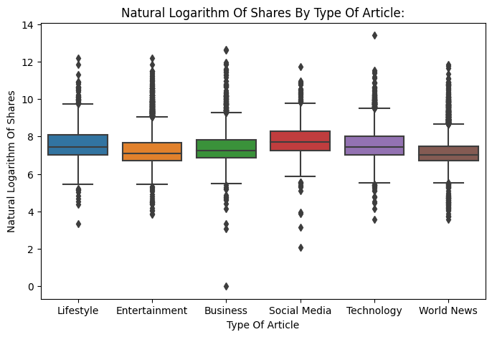
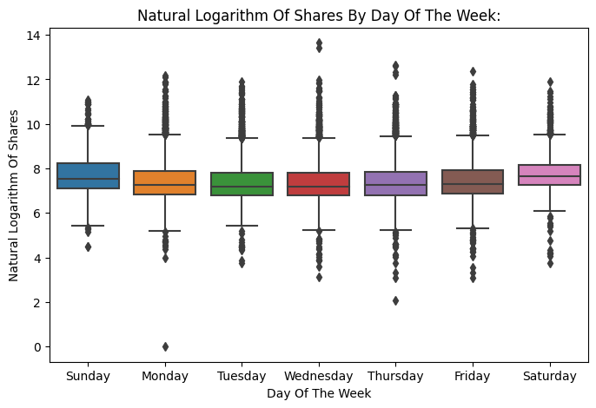
Feature Exploration & Visualization:

Slide 6
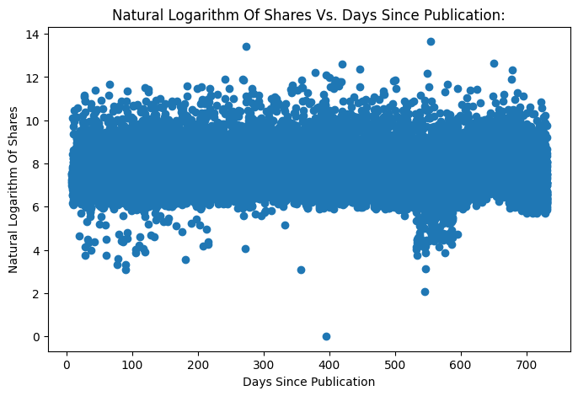
Feature Exploration & Visualization (II):

Slide 7
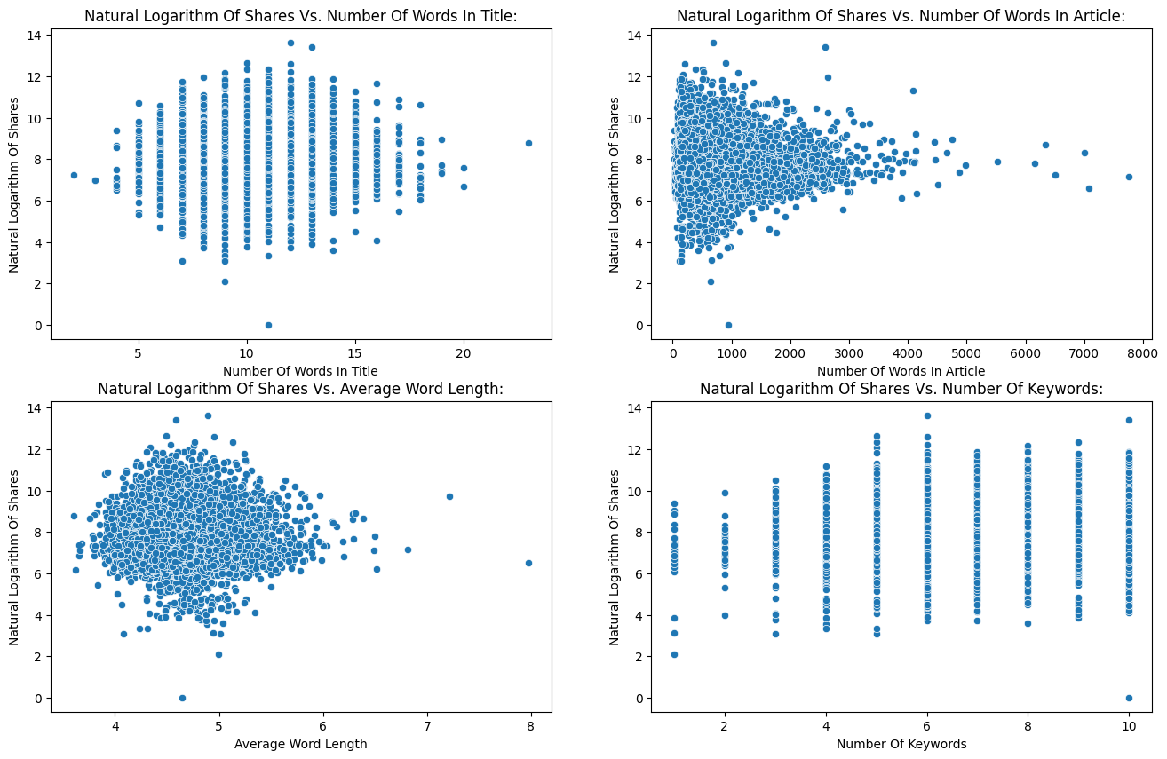
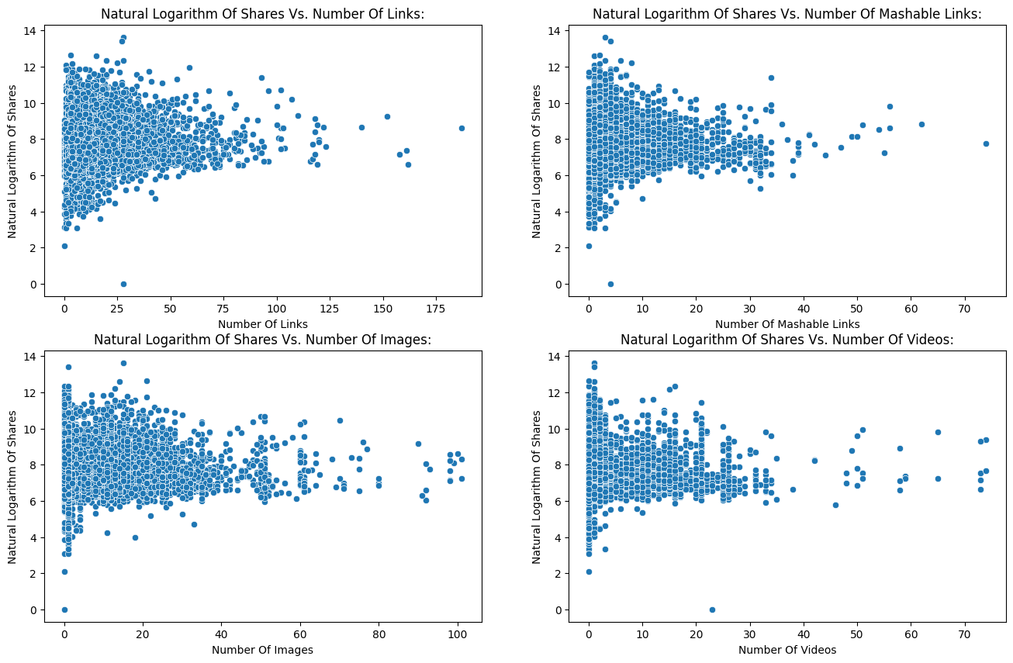
Feature Exploration & Visualization (III):

Slide 8
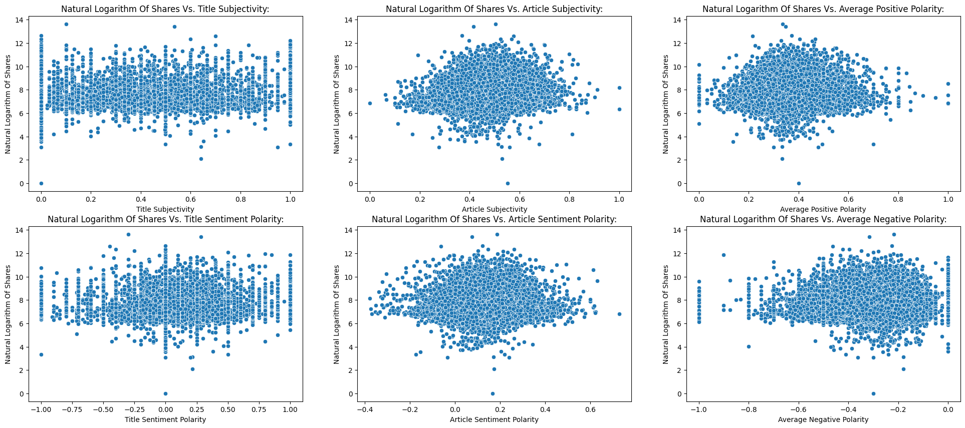
Feature Exploration & Visualization (IV):

Slide 9
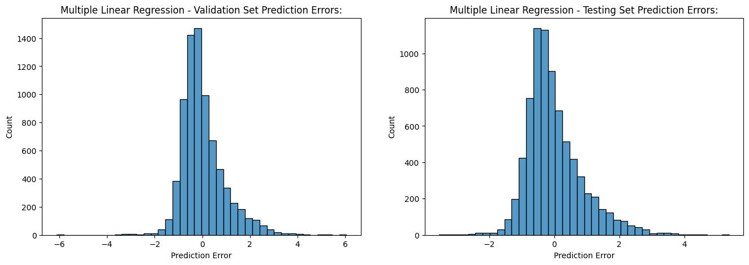
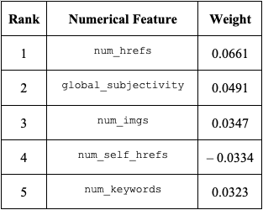
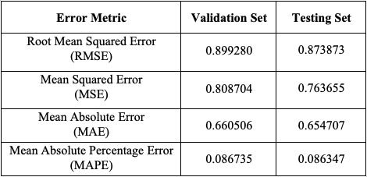
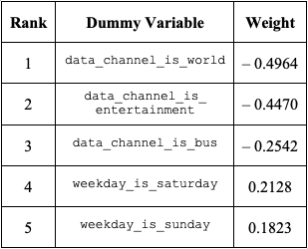
Multiple Linear Regression:

Slide 10
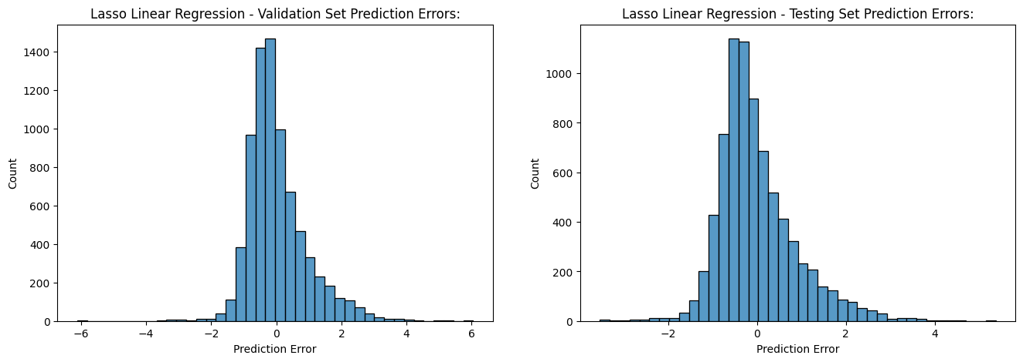
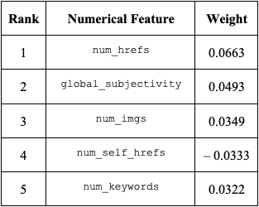
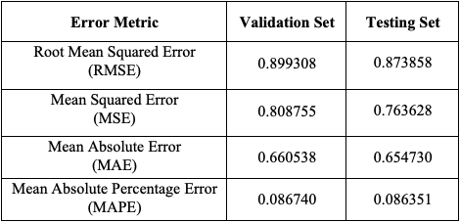
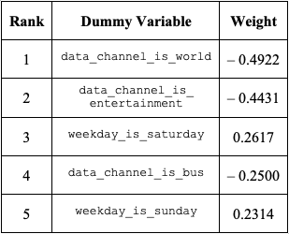
Lasso Linear Regression:

Slide 11

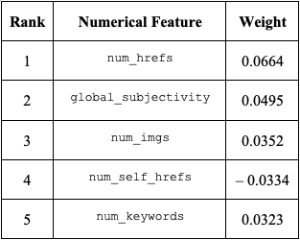


Ridge Linear Regression:

Slide 12
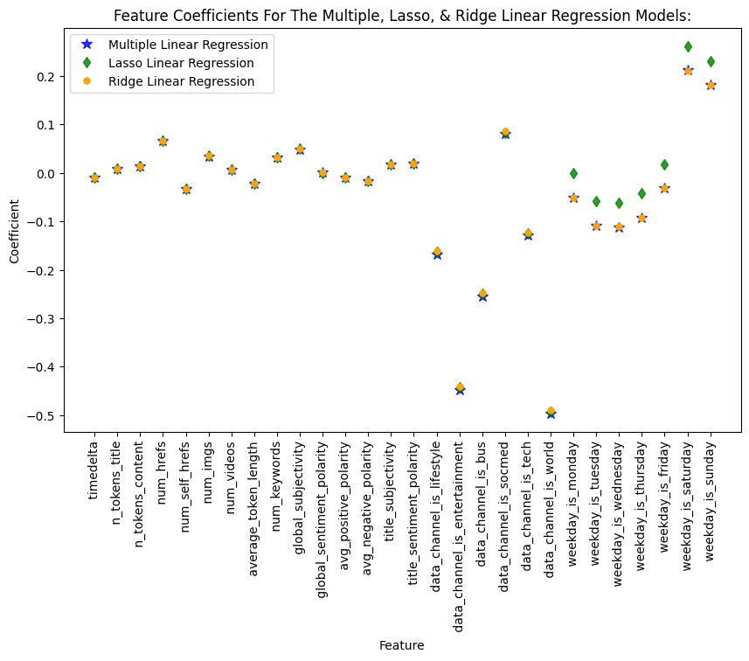
Comparison of Feature Coefficients:

Slide 13
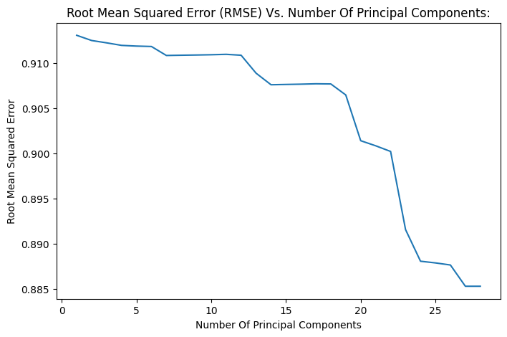

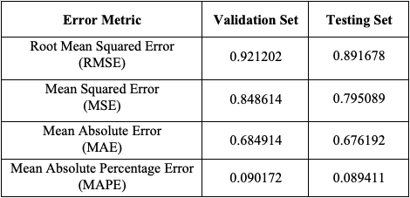
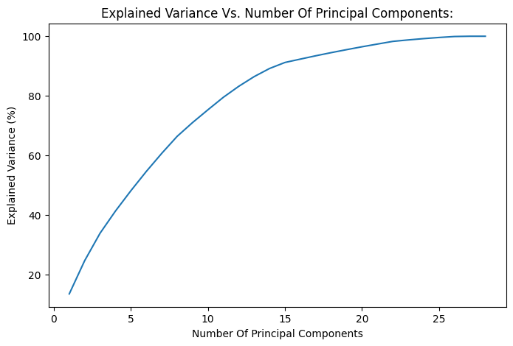
Principal Component Analysis Linear Regression:

Slide 14
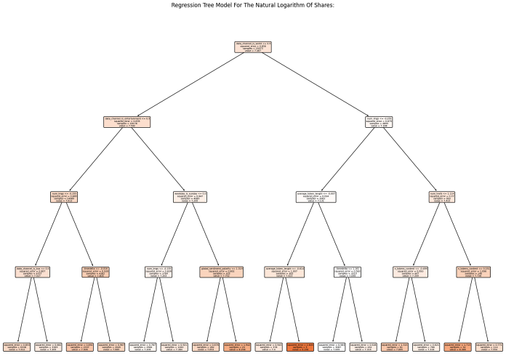
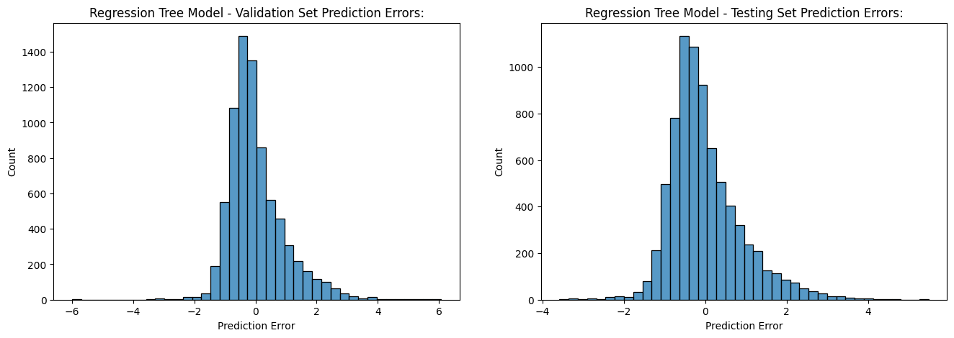
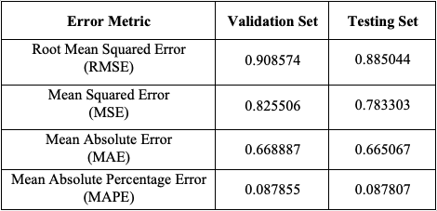
Regression Tree Model:

Slide 15
* Neural Networks:
The main focus of this project was on regression models for predicting the popularity of online news articles.
Just out of curiosity, neural networks were looked at as another potential predictive model.
However, the results of the neural network show that the model is overfitting, meaning that the training loss is decreasing but the validation loss is increasing.
As an illustration, the root mean squared error (RMSE) from the testing set was 7.538, which is much higher than those from the previous models and further confirms that the model is overfitting.
The model is not able to generalize to new data, suggesting that it is too complex. The data set may also be too small, and a larger data set could help with matching the model’s complexity without overfitting on the training data.
Or, this model may not be the right architecture for the task. A different model, like a convolutional neural network (CNN) may be more suitable. For example, in the improved model, the testing RMSE reduced significantly to about 1.538.

Slide 16
Project Results & Outcomes:
There is much consistency in the performance metrics and the prediction errors for the validation and testing sets across all of the different regression models investigated for this project.
However, there is still a lot of bias in these models. The combined bias and irreducible error terms for the multiple, lasso, and ridge linear regression models are about 7.766, 7.712, and 7.761, respectively.
The principal component analysis (PCA) linear regression model does manage to reduce the combined bias and irreducible term, but only slightly to approximately 7.467.
Perhaps using different feature scaling or keeping shares as the target variable, or even experimenting with polynomial or exponential regression would yield better results.
But in spite of these shortcomings, if companies are interested in real-world applications to getting accurate quantifiable popularity predictions of their online content, the solutions to this problem are likely to lie in regression methods and techniques.

Slide 17
References & Data Sources:
Esteban Ortiz-Ospina (2019) - “The rise of social media” Published online at OurWorldInData.org. Retrieved from: https://ourworldindata.org/rise-of-social-media [Online Resource].
Fernandes, Kelwin; Vinagre, Pedro; Cortez, Paulo; and Sernadela, Pedro. (2015). Online News Popularity. UCI Machine Learning Repository. https://doi.org/10.24432/C5NS3V.
Petrova, A. (2021). The Anatomy of Top Performing Articles: Successful vs. Invisible Content [Semrush Study]. Semrush. [Research Article]. Available at https://www.semrush.com/blog/anatomy-of-top-performing-articles/.
Pew Research Center. (2023). Digital News Fact Sheet. [Research Article]. Available at https://www.pewresearch.org/journalism/fact-sheet/digital-news/.
Richards, D. (2023). Shareable Content: What Is It? & Why Is It So Important?. [Online Post]. Available at https://tuckerhall.com/shareable-content-important/#:~:text=Shareable%20content%20can%20lead%20to,Social%20validation.
Shearer, E. (2021). More than eight-in-ten Americans get news from digital devices. Pew Research Center. [Research Article]. Available at https://www.pewresearch.org/short-reads/2021/01/12/more-than-eight-in-ten-americans-get-news-from-digital-devices/.
Statista. (2023). Social Media Advertising: market data & analysis. [Research Article]. Available at https://www.statista.com/study/36294/digital-advertising-report-social-media-advertising/#:~:text=The%20Social%20Media%20Advertising%20market,What's%20included%3F.

